Slide 1
Intelligent Plant Disease Identifier

Slide 2
Team Profile
Josh Hanson
  Math Minor
  Interested in Machine Learning and Game Development
  Team Leader
Eh Doh Kue Kyi
  Background in Web and Mobile Application Development
Matthew Murphy
  Double major in Computer Science and Mathematics
  Pursuing a Phd in Computer Science
  Main interests are Runtime Analysis and High Performance Computing

Slide 3
Team Profile
Mason Lewis
  Background in IT
  Interested in Mobile Development
David Markowski
  Cat named Ruby
  IVY Tech Transfer
  Minor Political Science

Slide 4
Outline
Project Information
Project Objective
Project Background
Project Expectations
Functional Requirements
Technologies/Resources
Testing and Development
Development Timeline

Slide 5
Project Information
Creating for Purdue Fort Wayne Computer Science Department
Project Advisor: Dr. Hajiarbabi
Focus on both research and development

Slide 6
Project Objective
Develop a plant disease identification and classification application utilizing Computer Vision, machine learning libraries such as TensorFlow, and React Native (Or preferred frameworks) which will be used to identify plant diseases to aid in the agricultural industry
  Experimentation using different libraries and frameworks
  ontribute to existing research

Slide 7
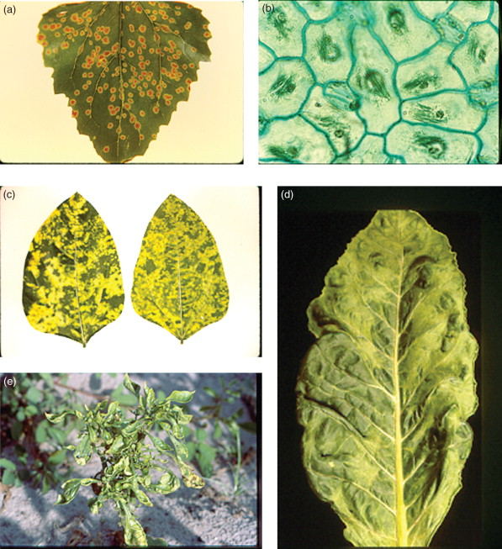
Project Background
Plant disease poses a substantial threat to agricultural production
Wheat, rice, maize, potatoes and soybean
(aka the “calorie crops”) face significant global pathogenic field loss
Pathogens are microorganisms such as bacteria, fungi, and viruses that deprive plants of nutrients and cause disease
These diseases create distinct patterns, marks, or lesions which can be used to uniquely identify the disease it is suffering from
Plants are also plagued by nutrient deficiency and pest infestations

Slide 8
Project Expectations
Utilize machine learning libraries and image processing libraries
Experiment with different model architectures and datasets to find optimal solution
Design a custom expert model for reliable disease recognition

Slide 9
Functional Requirements
User Input
  Users should be able to take pictures of
  plants to begin diagnostic process
  Users should be able to upload pictures as well
  Users can upload in batch
  Users will be able to put in metadata about a plant such as its species, location, growth stage, symptoms
Inference Engine
  Rule based logic and image classification
Diagnostics
  Possible diseases with confidence scores, suggest
treatments
  Able to differentiate between pathogens, pests, and nutritional deficiencies
  Knowledge base w/descriptors and visual patterns

Slide 10
Functional Requirements
Learning/Updating
  Retrain models with updated datasets, learn as information pertaining to new diseases becomes available
Reporting and Record-Keeping
  Automatically generate health report and keep records of reports for trend analysis
Runs on Android and other mobile devices

Slide 11
Non-Functional Requirements
Easy-to-use mobile interface for farmers, agronomists, and researchers
Accuracy and recall of >= 85%
Adapt to lighting conditions, background, and external factors affecting image quality (e.g., size, orientation)
Secure storage of image datasets and health reports
Diagnostic report should become available within 5 seconds per image
Detailed explanations for each diagnostic report

Slide 12
Stretch Goals
Chatbot integration
Prediction using historical and environmental, and weather data
Treatment plan recomendations
Language support
iOS app

Slide 13
Technologies/Resources
TensorFlow/Keras for deep learning, testing, and validation
OpenCV to process images
Android Studio, React Native, etc for mobile application dev
PlantVillage dataset

Slide 14
Development Timeline
Weeks 1-4 | Research Stage
Weeks 5-12 | Prototyping CNN and Expert model
Weeks 13-15 | Deploy combined system for online mobile access Design Android app and UI
Week 16 | Present prototype

Slide 15
Possible Organizational Tools
Discord and email for communication
Kanban for task organization
GitHub
Google Docs/Drive

Slide 16
Challenges
Scope of Project
Financial
Time

Slide 17
In the End…
Plant disease, malnourishment, and infestation plague the agricultural industry
ML models and image classification can be extremely useful for diagnostics, reporting, and preventative action
We intend to create an application which integrates these three elements to create an all-purpose diagnostic tool

Slide 18
Works Cited
https://councilonstrategicrisks.org/2024/06/13/pest-and-pathogen-threats-to-food-security/
https://www.sciencedirect.com/science/article/abs/pii/S0168169922002095#:~:text=Disease%2Dinfected%20plants%20tend%20to,used%20to%20diagnose%20plant%20abnormalities.

